Slide 1
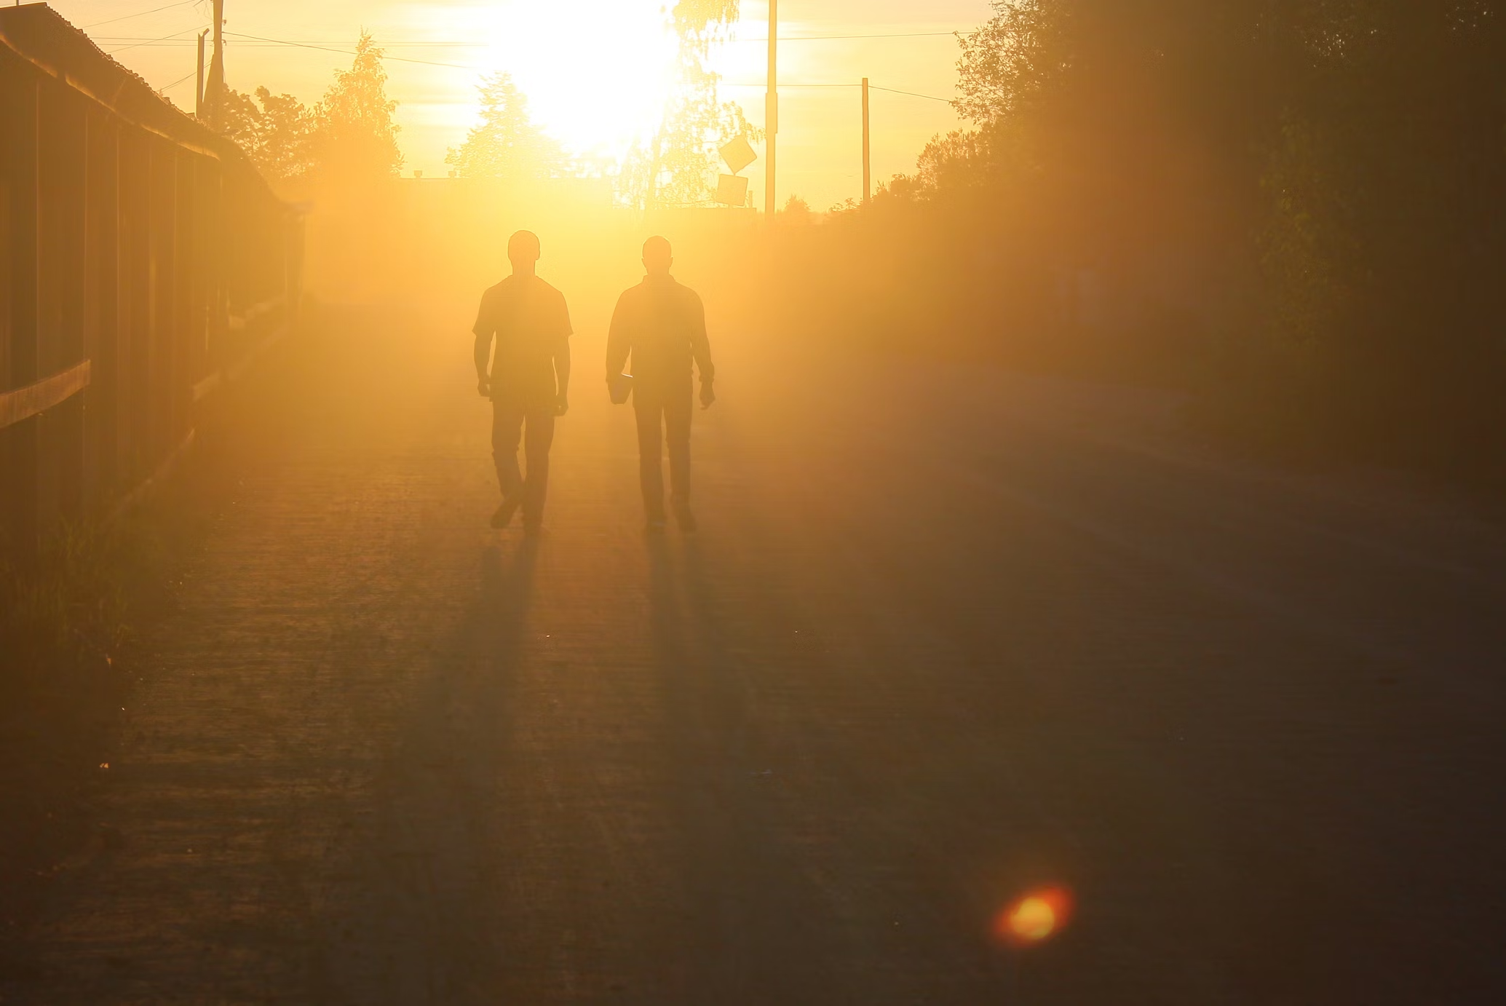
Rise Up, O Men of God
"Be watchful, stand firm in the faith, act like men, be strong“ ~1 Corinthians 16:13
Notes:
God’s people are to heed the call to rise up and serve their King, leaving lesser things behind as they give their all to build the church and prepare themselves for the eternal Kingdom.

Slide 2
“Have done with lesser things”
Everything is “less than” heavenly things.
Who is sufficient for these things (2 Corinthians 2:15-16; 3:4-5; 4:7)?
The vessels God uses are made of earth but cleansed for His use (2 Timothy 2:19-21).

Slide 3
“Have done with lesser things”
Sin involves lesser things (Romans 6:21-23).
With God’s help, we can rise (Micah 7:8-9).
Earthly achievements are lesser things (Phil. 3:7-14; 4:8).
Childish things are lesser things (1 Corinthians 13:11).

Slide 4
Give heart, soul, mind and strength to serve the King of Kings!
What is the first commandment (Mark 12:29-30)?
Are we ready to give our lives in His service (Mark 8:34-35; Acts 15:26; 20:24; 21:23)?
How will we serve our King, the Son of David (2 Samuel 23:15-16)?

Slide 5
His kingdom tarries long. Bring in the day of brotherhood and end the night of wrong.
“His kingdom tarries long.” (2 Peter 1:10-11).
To prepare for it, we must strive to bring in the day of brotherhood (1 Peter 2:17; 1:22; Galatians 5:13; 1 John 3:14, 16).
We strive to end the night of wrong by shining truth’s light (Ephesians 5:8-17; 1 John 2:10).

Slide 6
The church for you doth wait, Her strength unequal to her task; Rise up and make her great!
The church is the body of Christ (Ephesians 1:22-23; 5:23).
The church must be built and strengthened (Ephesians 4:15-16; 1 Peter 5:10).
Let us rise up and build! (Nehemiah 2:18).

Slide 7
Lift high the cross of Christ! Tread where His feet have trod. As brothers of the Son of Man, Rise up, O men of God!
We lift high the cross by preaching Christ and not ourselves (1 Cor. 1:18, 26, 2:1-2).
We illustrate the message by walking as Jesus did (1 Peter 2:21-22).
In this way we show ourselves to be “brothers of the Son of Man” (Hebrews 2:11-12; Mark 8:38).

